Slide 2
The state and future
of Wasm in Dapr
Loong Dai

Slide 3

Self Introduction
戴翔
Loong
Intel Engineer
Dapr/Thanos/Golangci-lint Maintainer

Slide 4
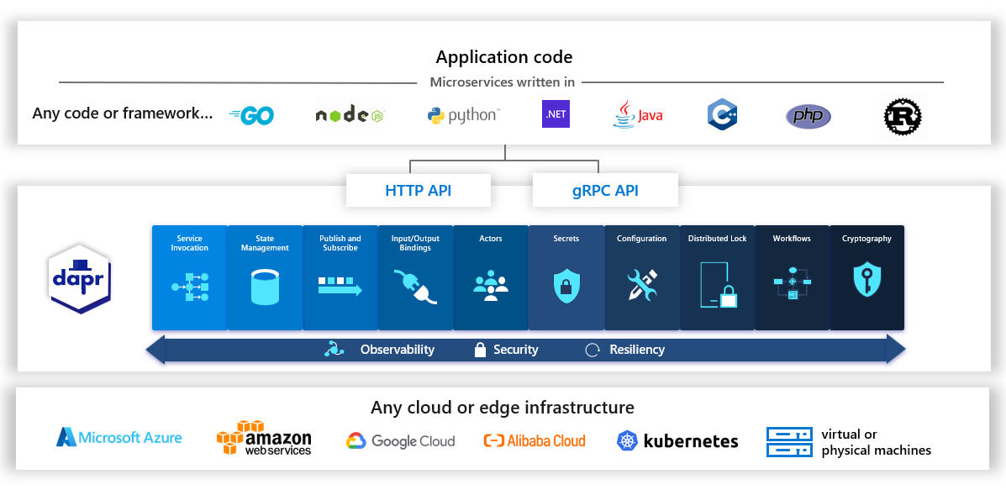
Dapr: help build microservice

Slide 5
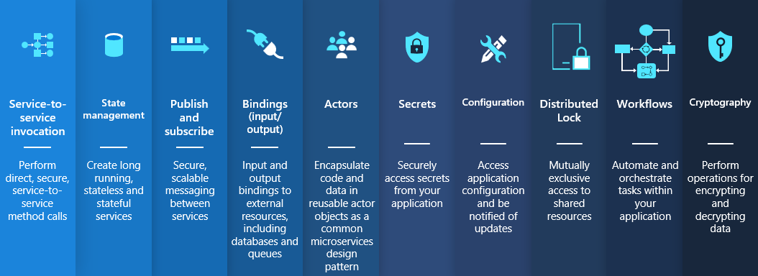
Useful and independent APIs(Building Blocks)

Slide 6
Wasm: A Portable Compilation Target
WebAssembly (abbreviated Wasm)
a binary instruction format
Stack-based virtual machine
Enabling deployment on the web for client and server applications
Many languages support

Slide 7
Dapr & Wasm
Dapr
Help build microservice
Run in any hosting environments that Dapr integrates with
Many languages support
Wasm
Enable deployment one the web
Sandboxed execute
Many languages support
Web services are trending more toward microservice arch
Platform agnostic, run anywhere

Slide 8
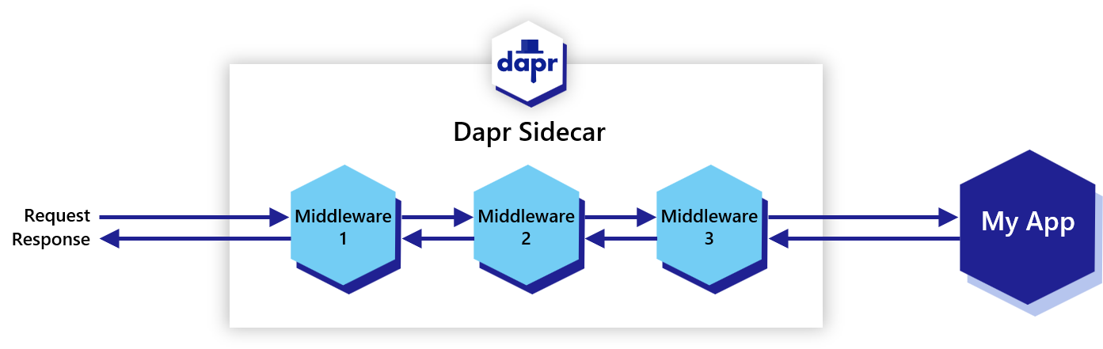
The beginning of Dapr & Wasm

Slide 9
Pain Points
dapr/component-contrib repo
dapr/dapr repo
Release
Get it!
Review
Contribute
Merge
Contribute
Built-in codes
long time to integrate
Review
Merge

Slide 10
Pain Points
Poor flexibility
Limited configuration options
cannot support customized requirements
Need upgrade to use new features
Poor privacy
The business core codes may be public

Slide 11
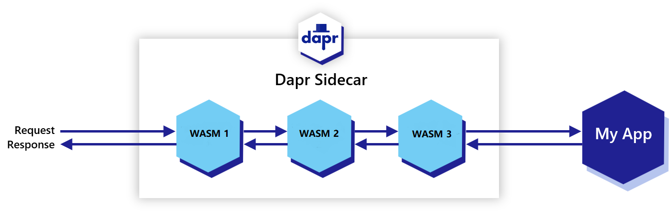
How Wasm helps

Slide 12
How Wasm helps
Built-in codes
Long time to integrate
Limited configuration options
Cannot support customized requirements
Need upgrade to use new features
Poor privacy
Wasm binary
No longer need
Customize
Dynamic loading
Keep privacy

Slide 13
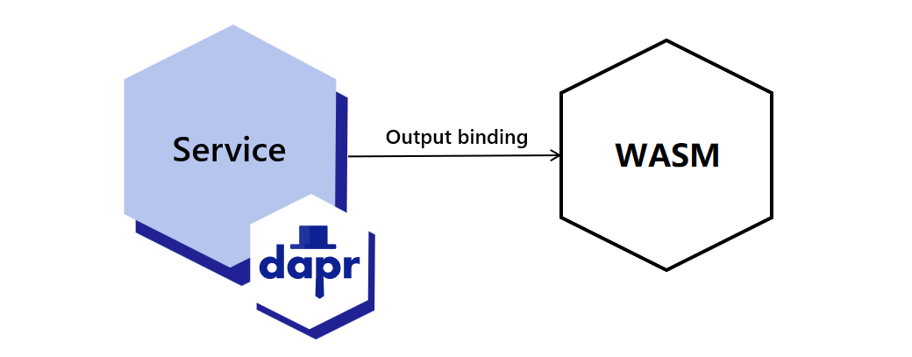
More than Middleware

Slide 14
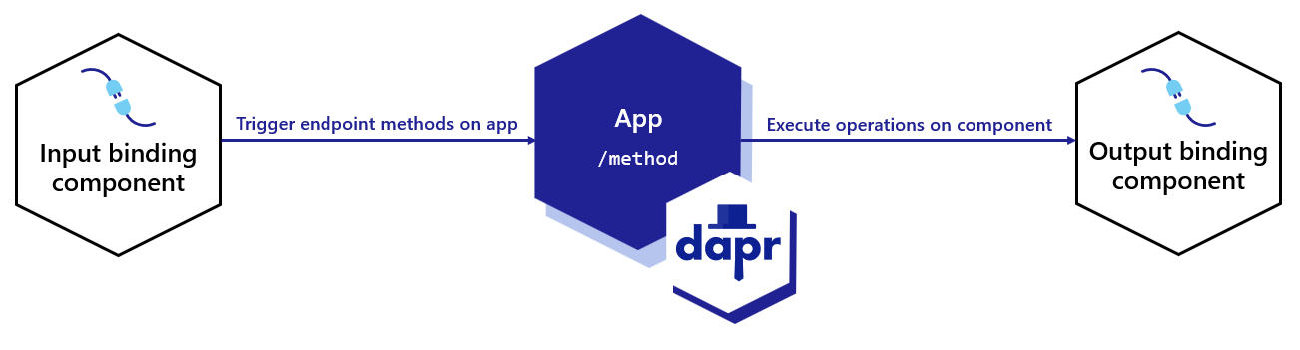
Bindings
Notes:
Avoid the complexities of connecting to and polling from messaging systems, such as queues and message buses.
Focus on business logic, instead of the implementation details of interacting with a system.
Keep your code free from SDKs or libraries.
Handle retries and failure recovery.
Switch between bindings at runtime.
Build portable applications with environment-specific bindings set-up and no required code changes.

Slide 15
Future
Increase concurrency performance
Call Dapr components in Wasm codes directly
Improve security
Strict sandbox – enforce limits on time and file access
Native Wasm SDK
…

Slide 16
Mail: loong.dai@intel.com
Github: daixiang0
Thank you!

